Slide 1

Cloud-Powered Search Engine with Puppeteer
DOMAIN : Cloud computing with aiml

Slide 2
TEAM Members
IV IT - A
1) KAVIN T - 727821TUIT050
2) HARI KRISHNAN A – 727821TUIT030
3) ATHIF M – 727821TUIT013
Supervisor: Dr. A. Christy Jeba Malar - AsP/IT

Slide 3
Problem Definition / Abstract
Building a search engine requires the ability to crawl, extract, and index content from dynamic / Single page websites.
Traditional web scrapers struggle with modern Single Page Applications (SPAs) due to dynamic content loading via JavaScript.
This project aims to address these challenges by leveraging Puppeteer Cluster on top of Chromium to crawl SPAs and extract data, which is then indexed in Cosmos DB for fast retrieval.

Slide 4
Objectives
Develop an Efficient Web Crawler: Implement a scalable web crawler using Puppeteer Cluster to extract content from websites, including those using SPAs.
Enable Reliable Data Indexing and Search: Store and index extracted data in Cosmos DB, enabling fast and accurate search results for the small-scale search engine.

Slide 5
Existing System
Traditional Web Scrapers: Typically rely on fetching the HTML content of a page and parsing it using techniques like regex. While suitable for simple websites / static web sites, they face significant limitations:
Incompatibility with SPAs: Traditional scrapers cannot handle dynamic content loaded via JavaScript, making them ineffective for many modern websites.
Complex Data Extraction: Extracting data from HTML using regex or basic parsers is tedious and error-prone.
No JavaScript Execution: Standard scrapers do not render JavaScript, leading to incomplete or missing data from dynamically generated pages.

Slide 6
Proposed System
Advanced Web Scraping with Puppeteer and Chromium:
Utilizes a headless browser (Chromium) controlled by Puppeteer to mimic human browsing, enabling effective scraping of SPAs by rendering JavaScript.
Employs Puppeteer Cluster for parallelized and scalable crawling, ensuring efficient data collection from multiple websites.
Content Indexing in Cosmos DB:
Extracted data is stored and indexed in Cosmos DB, a globally distributed, highly scalable database service, allowing fast search and retrieval.

Slide 7
Flow diagram
Start
CSV File Upload
WWW
Multiple Requests
Crawler (Puppeteer)
Data Storage
MongoDB
(Raw Data)
Content Extractor
Indexing (Python Script)
Indexed DB
Index
Modular
Query Processor
User Request (UI)
Data Ranking & Retreival
(Page Rank Algorithm)
MongoDB
(Fetch Data)
Display Ranked
Results
End
USERS

Slide 8
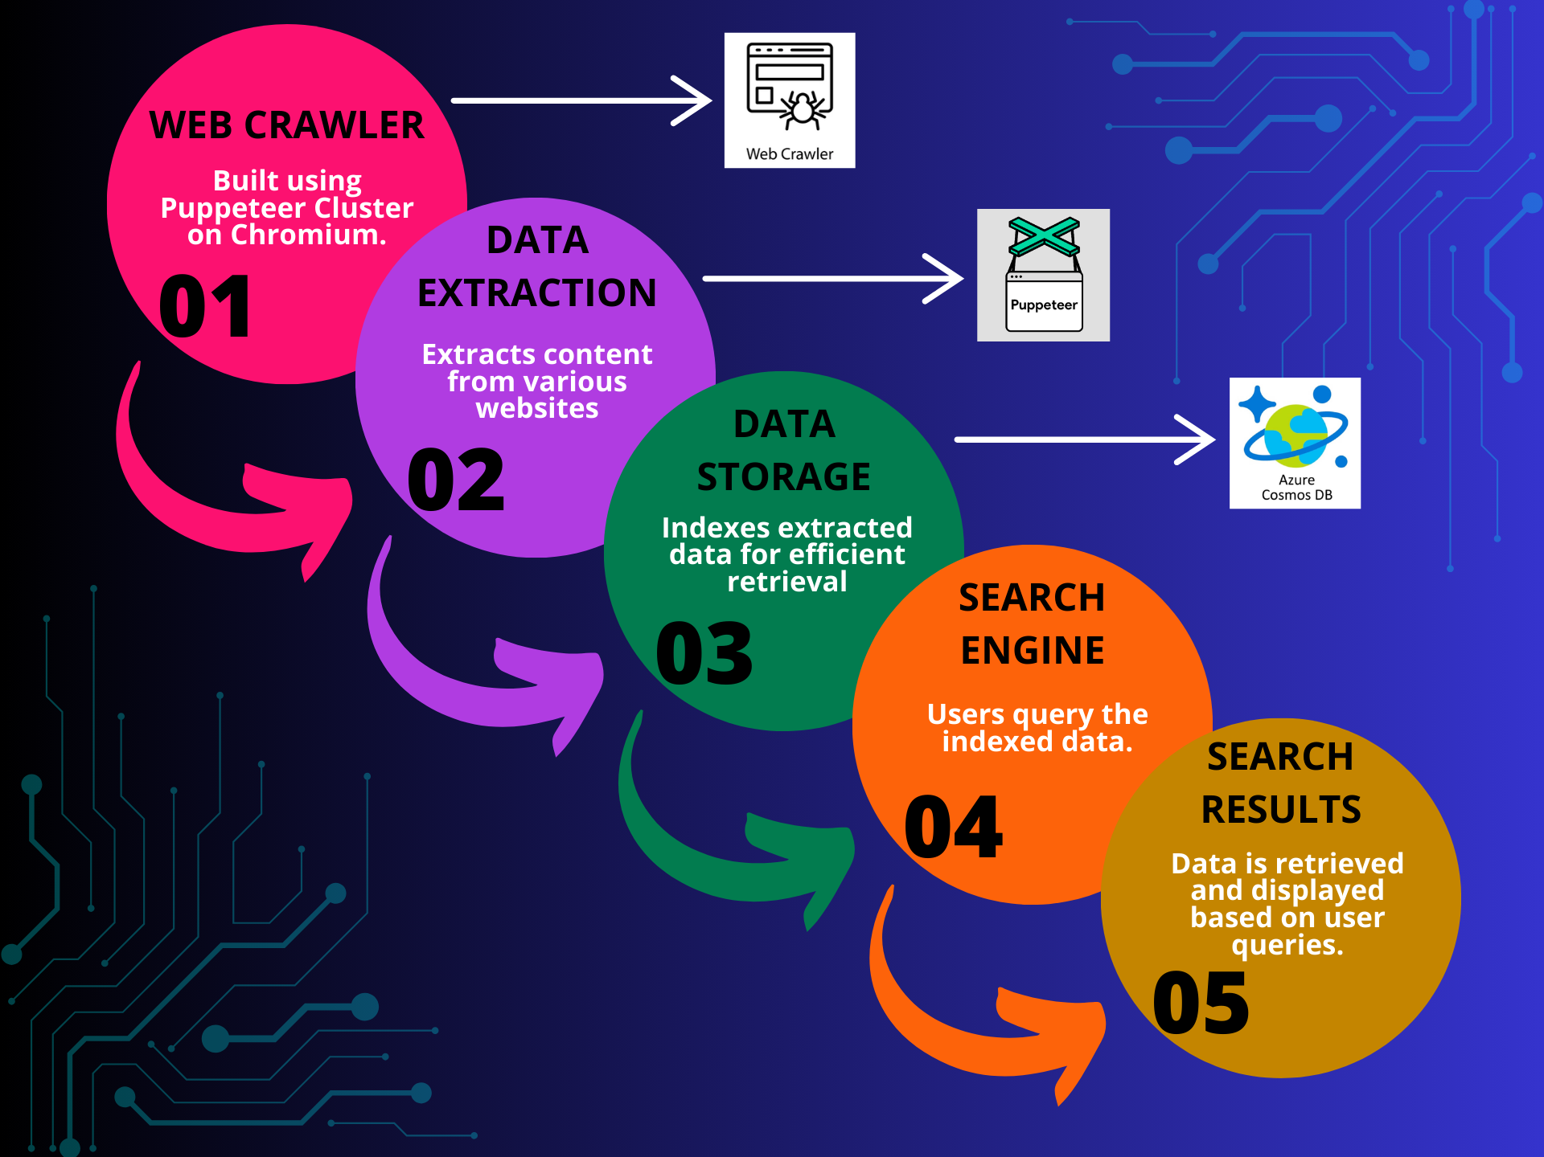
Architecture Diagram

Slide 9
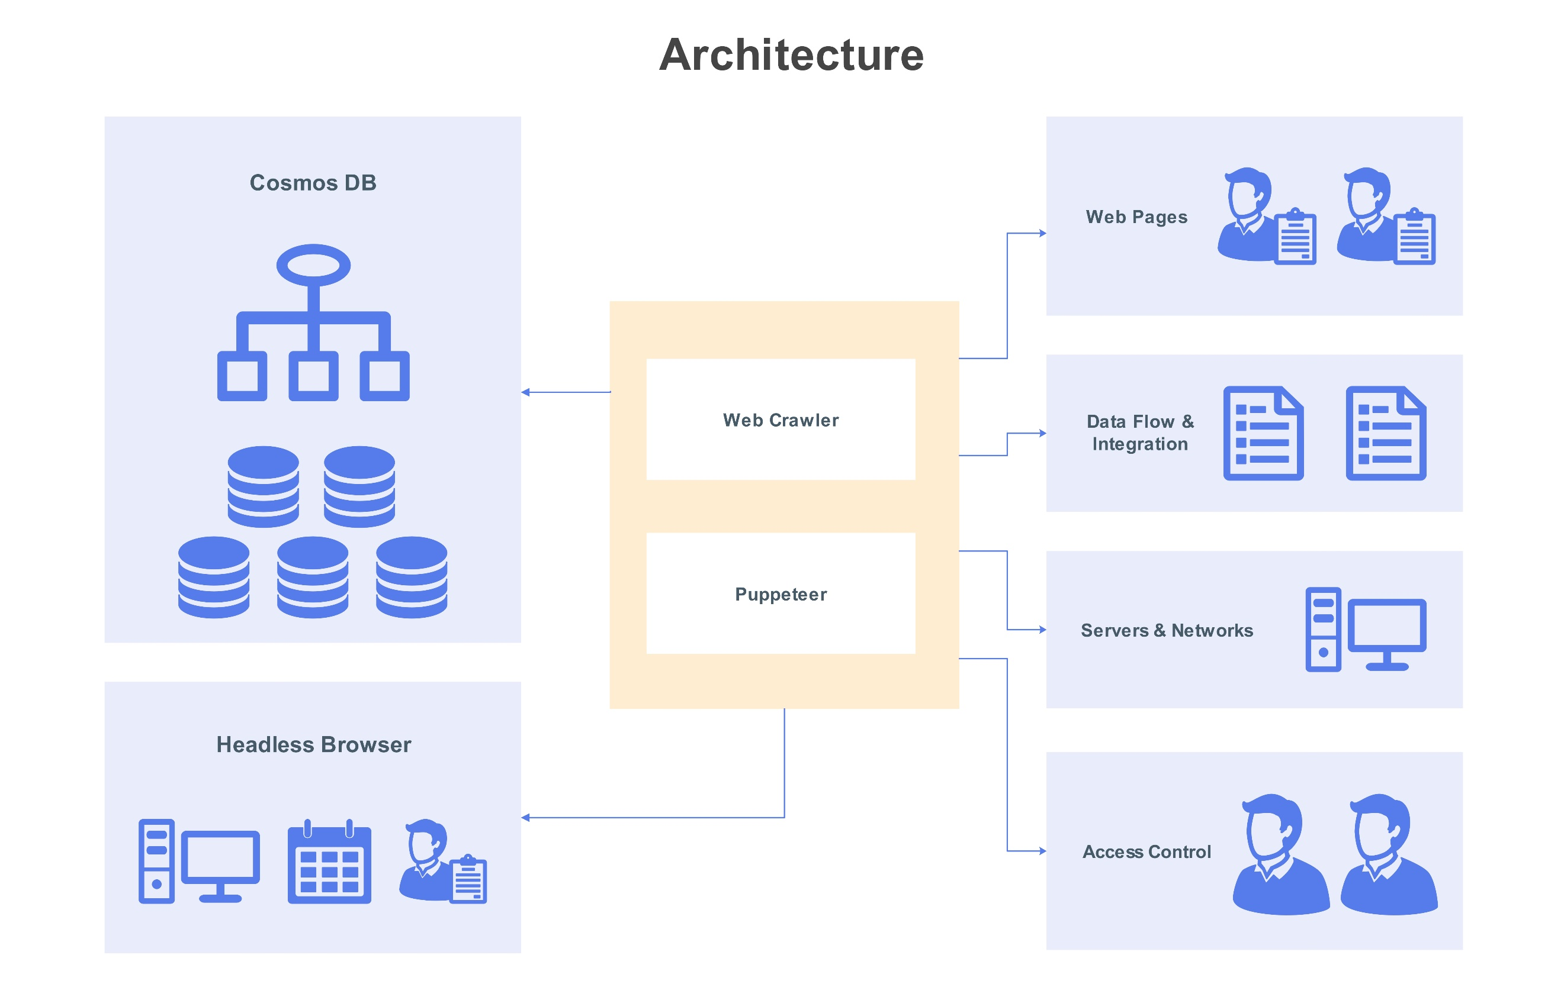
Block diagram of architecture

Slide 10
Conclusion
Effective Solution: The project successfully demonstrates the use of Puppeteer and Chromium for web crawling, providing an effective solution for extracting data from modern JavaScript-heavy websites, including Single Page Applications (SPAs).
Scalability and Efficiency: By employing Puppeteer Cluster, the crawler achieves scalable and efficient data collection, capable of handling multiple websites in parallel.
Robust Data Management: The integration with Cosmos DB ensures that extracted data is indexed and searchable, enabling quick retrieval and efficient search functionalities.

Slide 11
THANK YOU

